Slide 1

AQE Training Project
By Prathmesh Khose

Slide 2

1 Springboot project creation
2 Github project push
3 Jenkins Automate CI/CD pipeline
4 Docker

Slide 3
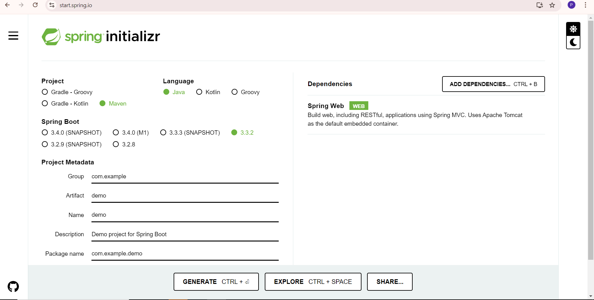
1 Spring boot project creation

Slide 4
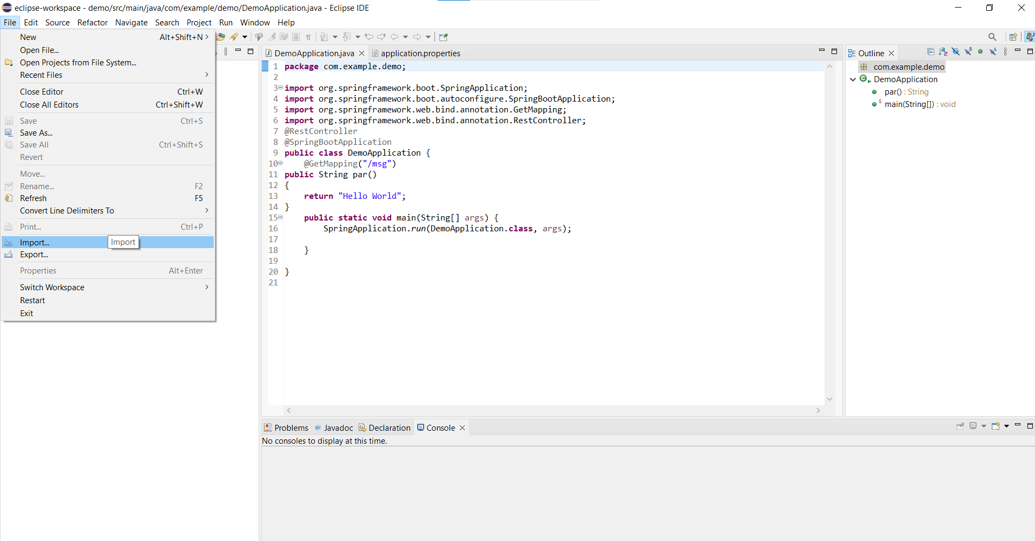
Open the eclipse and choose the following step

Slide 5
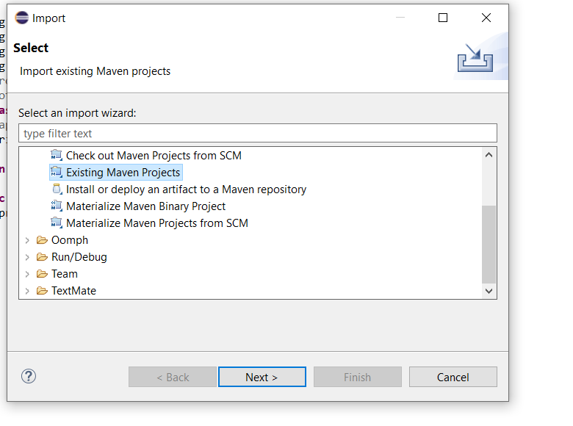

Slide 6

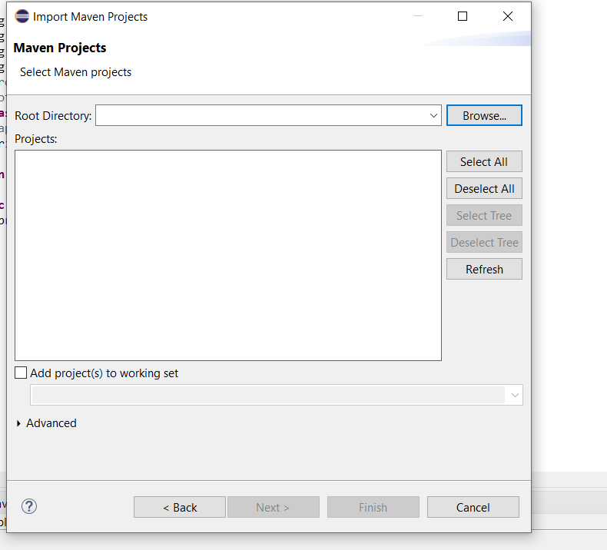
In browse option select the spring initialized unzipped file

Slide 7
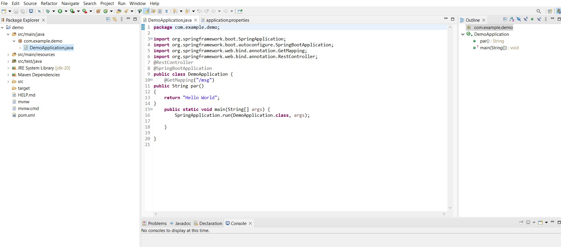
Make changes in the code and created method named par for showing the message on web browser

Slide 8
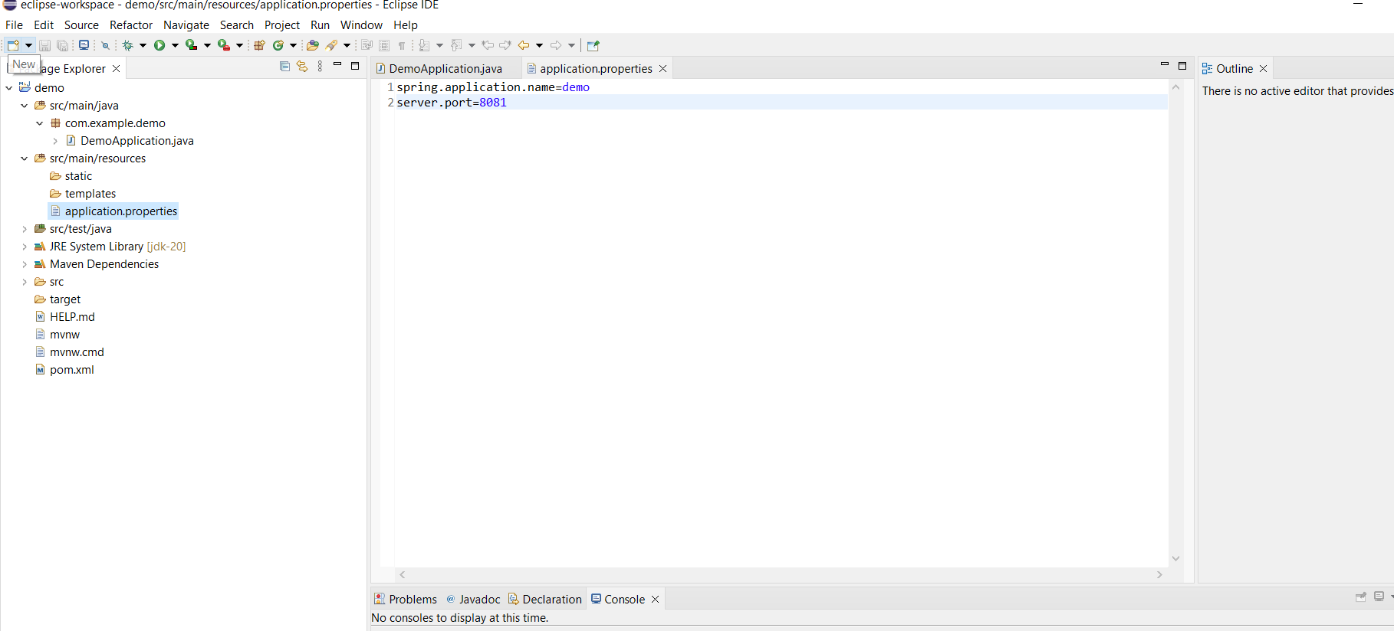

Slide 9
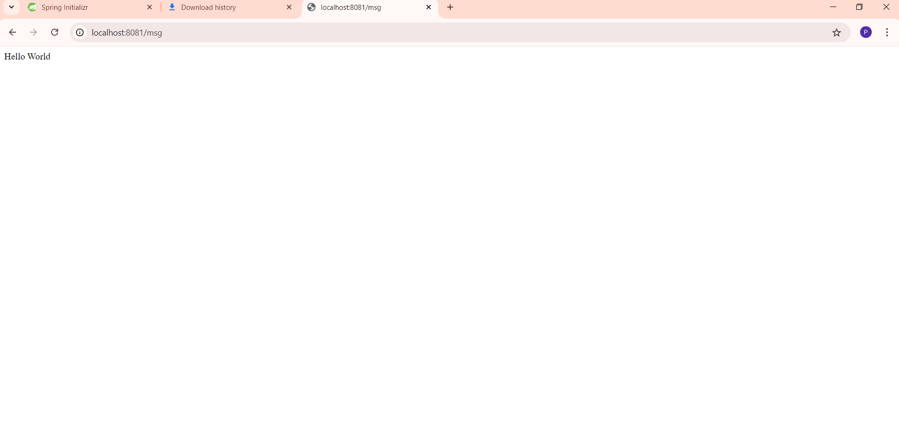

Slide 10
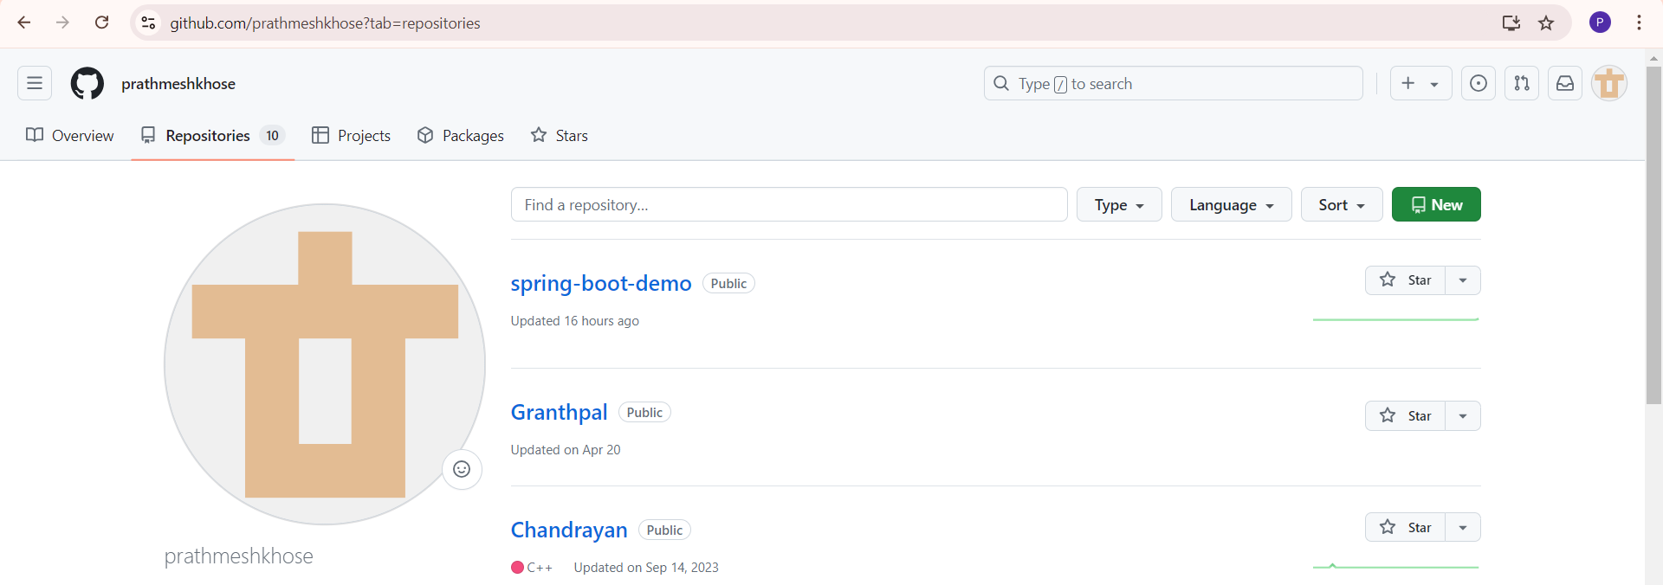
2. Github project push
In your github account create new repository and push the project on it using given commands

Slide 11

Steps to push project on github
git init
git add .
git commit –m “message”
git remote add origin git remote add origin https://github.com/prathmeshkhose/spring-boot-demo/tree/main/demo
git branch –m main
git push –u origin main

Slide 12
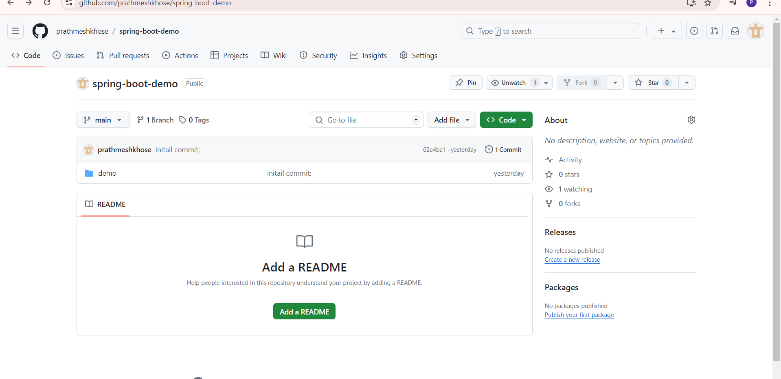
Final github results

Slide 13
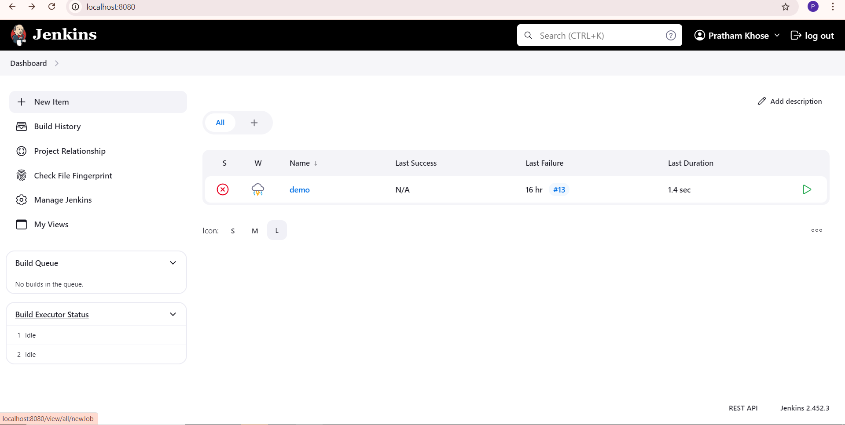
3 Jenkins Automate CI/CD pipeline

Slide 14
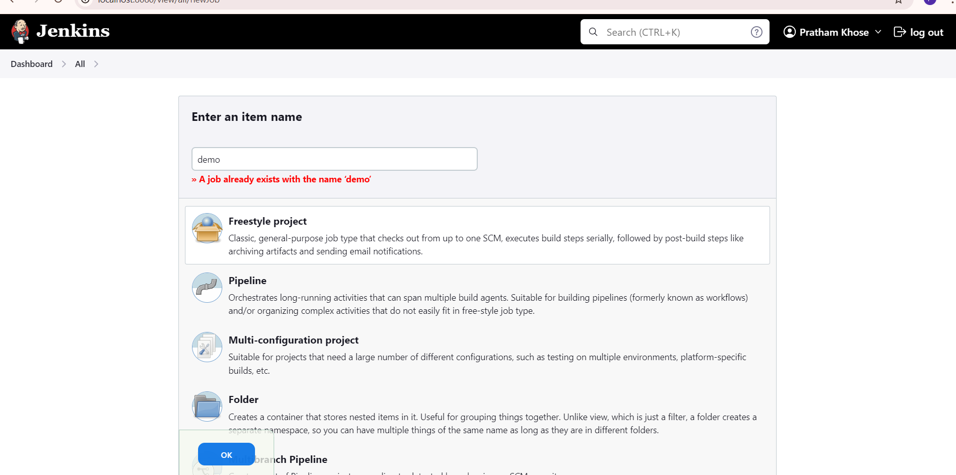

Slide 15
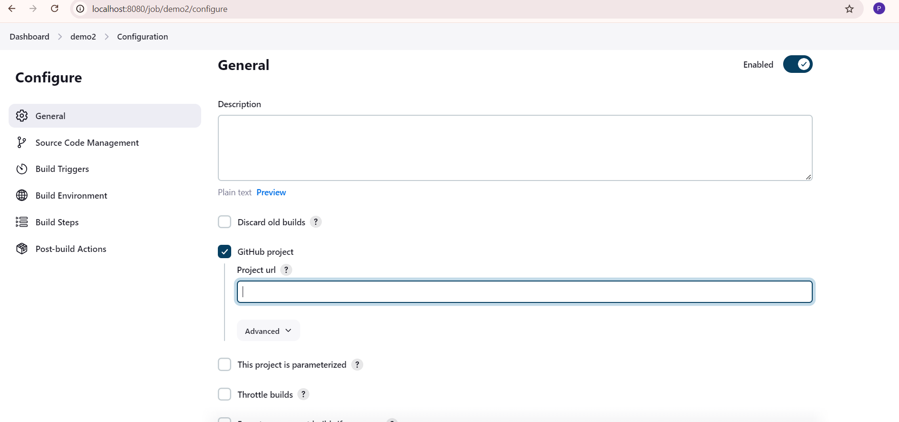
Enter the github url present at the top

Slide 16
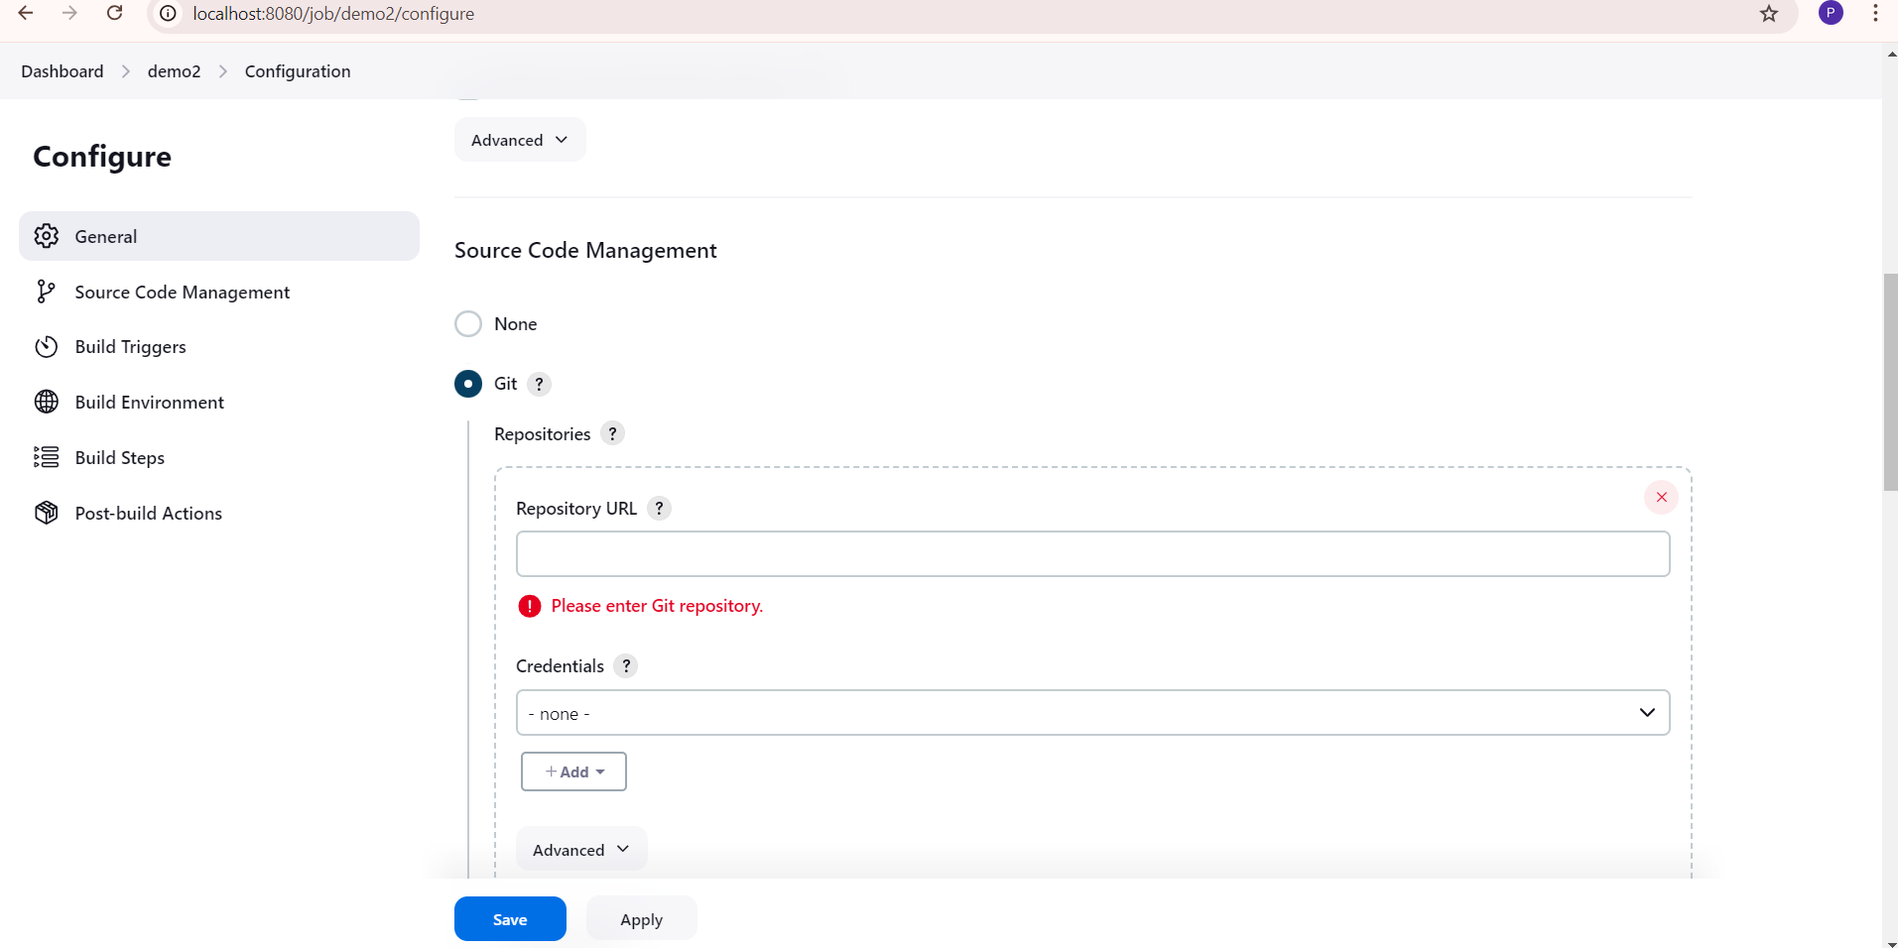
Add repo url and credentials of jenkin

Slide 17
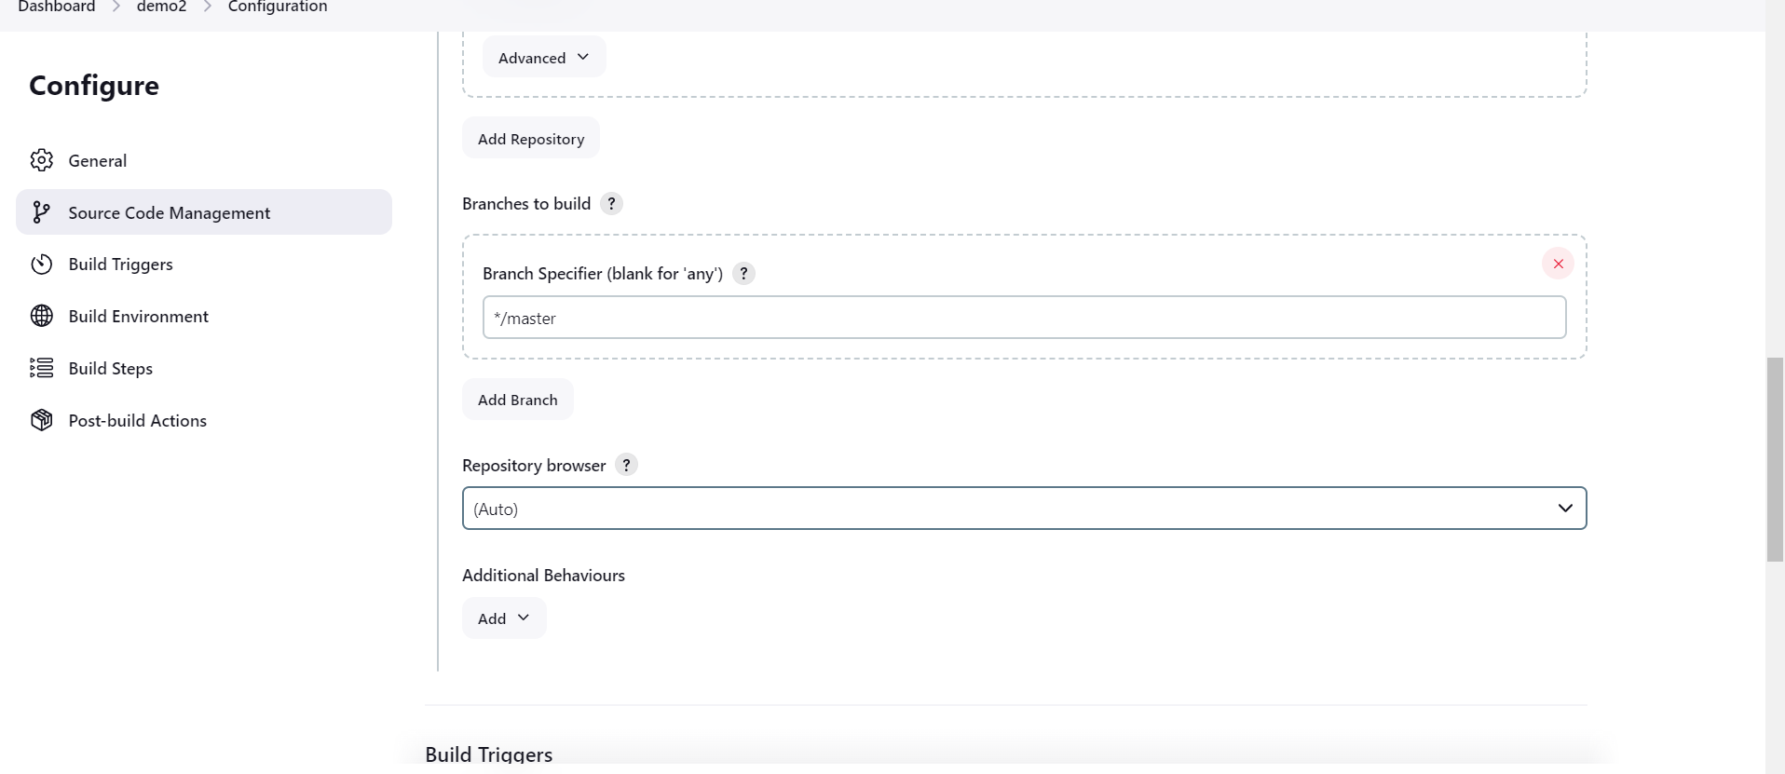

Slide 18
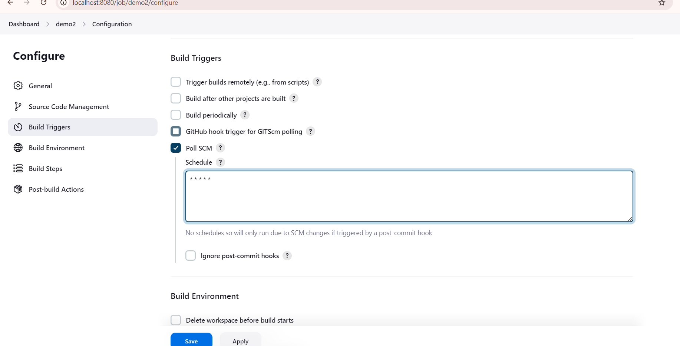

Slide 19
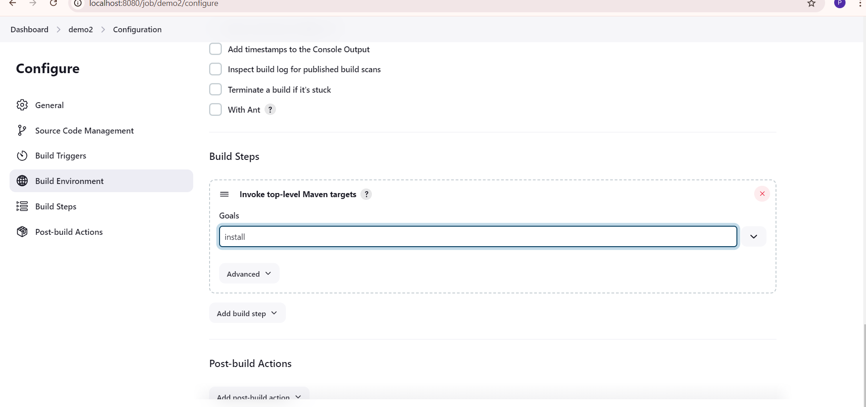
After this click the button save

Slide 20
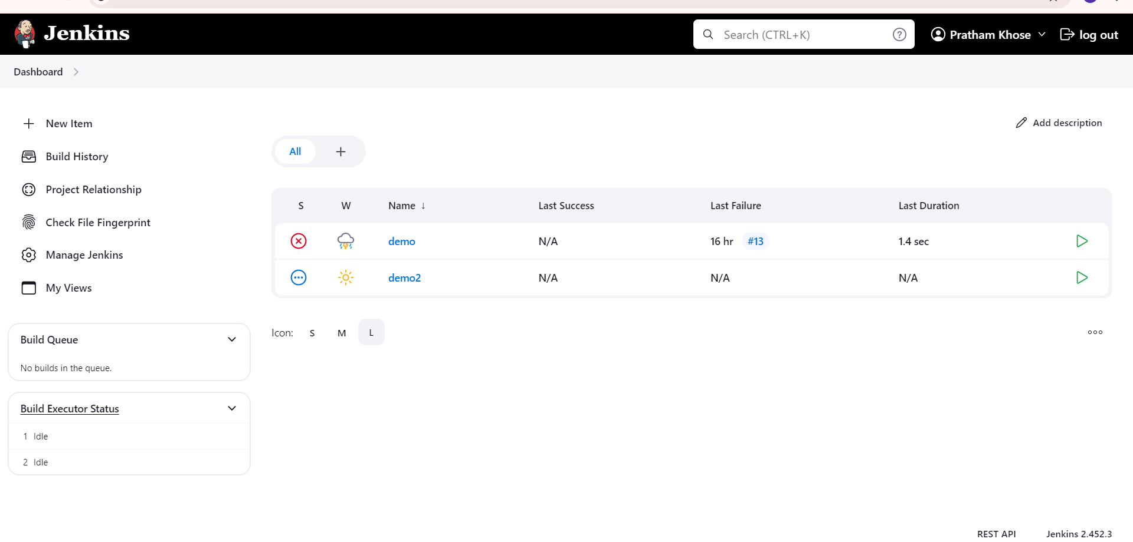

Slide 21
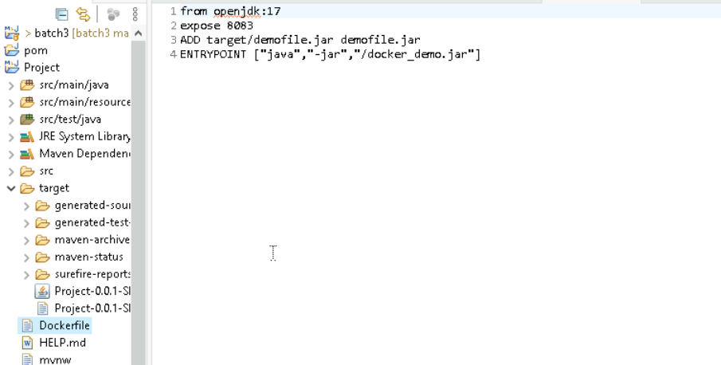
Dockerizing the project
Contents in Dockerfile

Slide 22
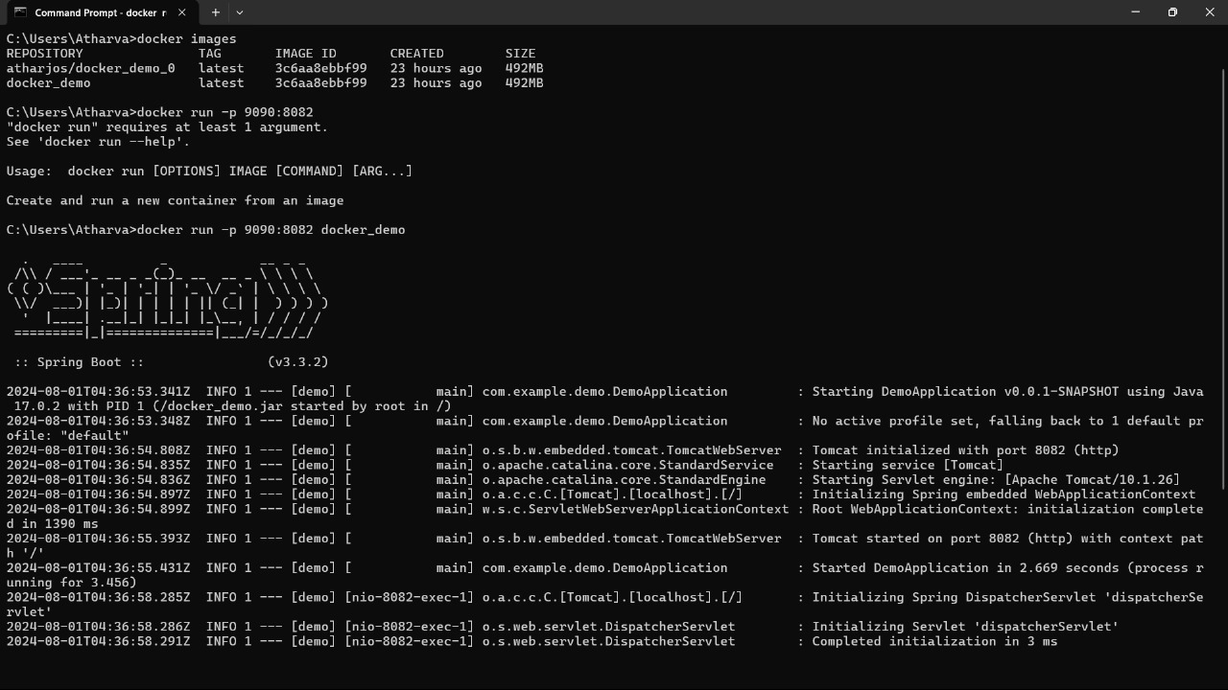
Dockerizing the project
Commands used to dockerize the project
Docker –version
Docker images
Docker build –t project_name
Docker run –p 9090:8083 project_name
Docker tag project_name
Docker pull img_name

